Slide 1
Working in a group
Based on original materials developed by Learning to Learn Project, The Hong Kong
Polytechnic University

Slide 2
Outline
Basic elements of effective group work
Team building
Communication
Decision making
Interpersonal conflicts
Leadership
Reflect on your group work

Slide 3
Basic elements of effective group work

Slide 4
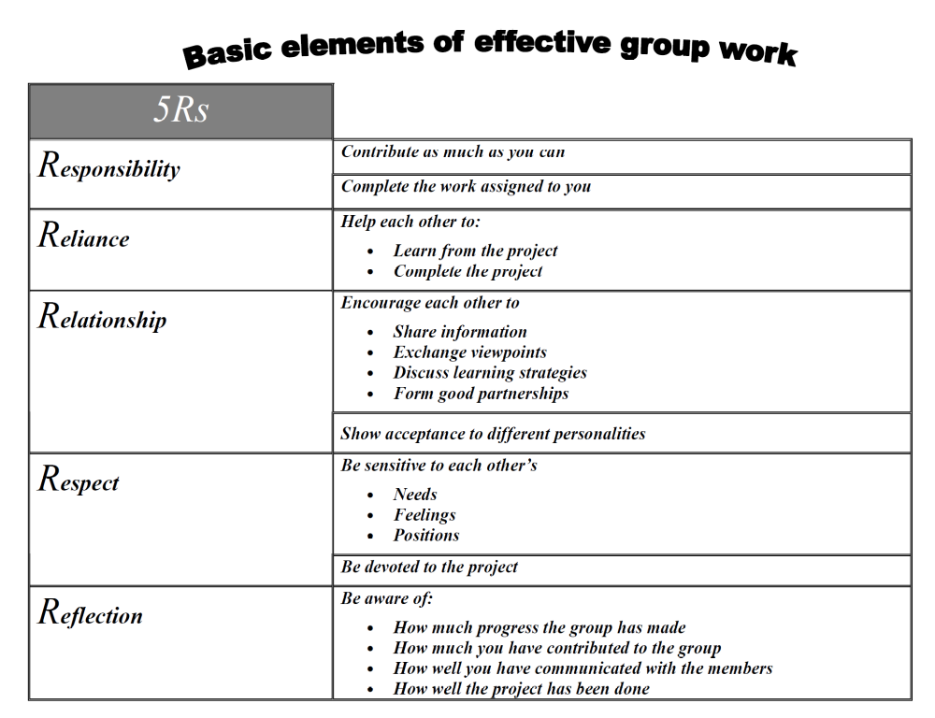

Slide 5
Team building

Slide 6
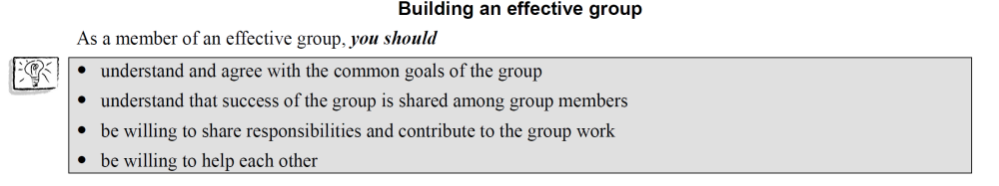

Slide 7
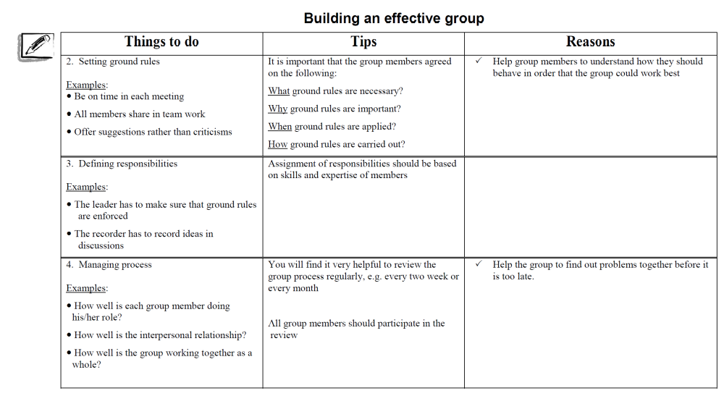

Slide 8
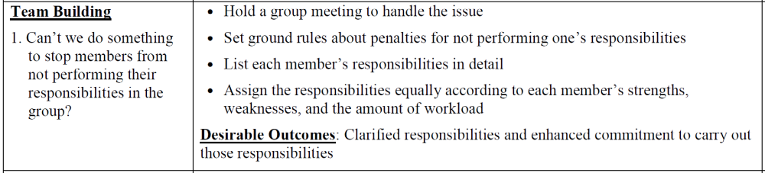

Slide 9
Communication

Slide 10
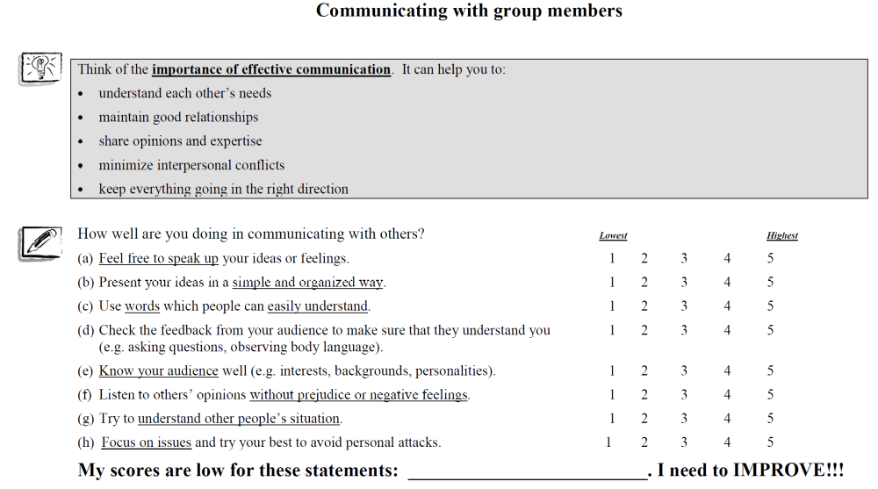

Slide 11
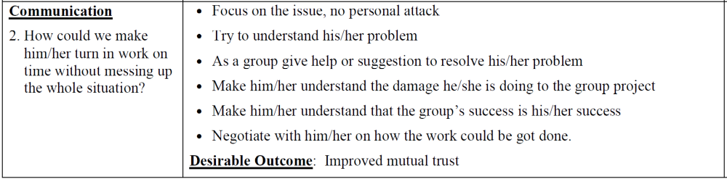

Slide 12
Decision Making

Slide 13
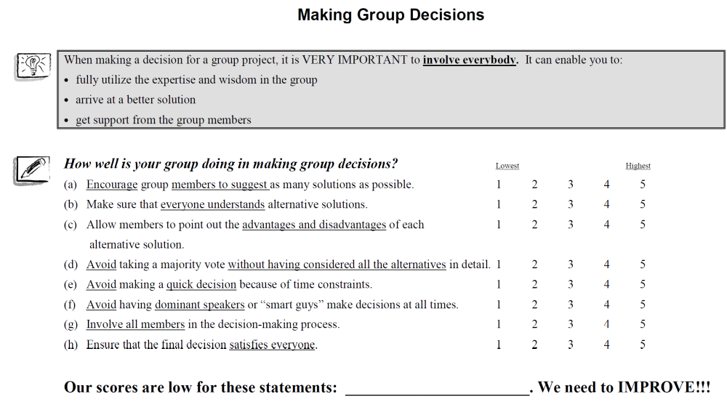

Slide 14
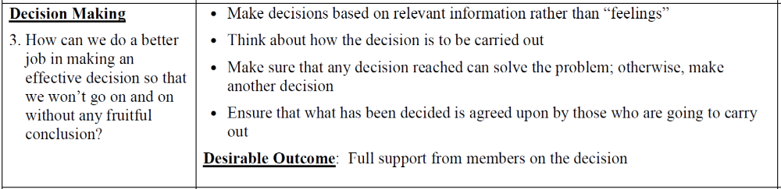

Slide 15
Interpersonal Conflict

Slide 16
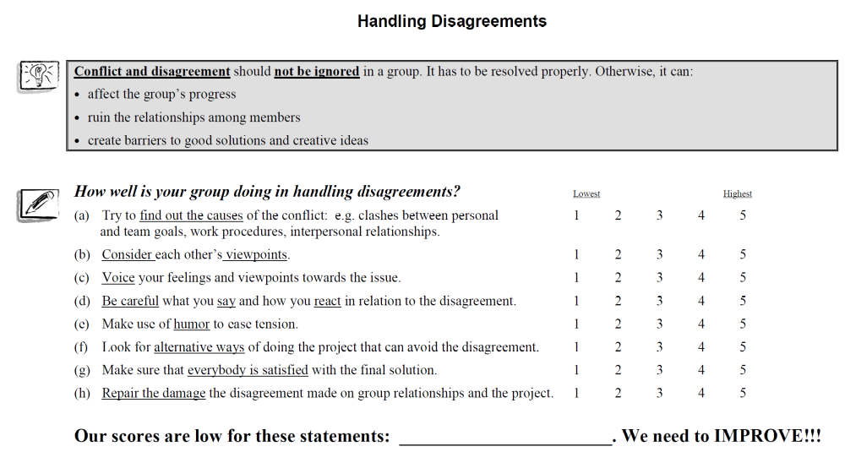

Slide 17
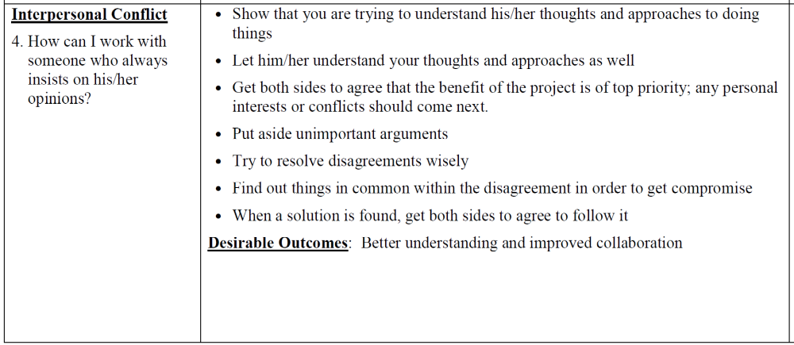

Slide 18
Leadership

Slide 19
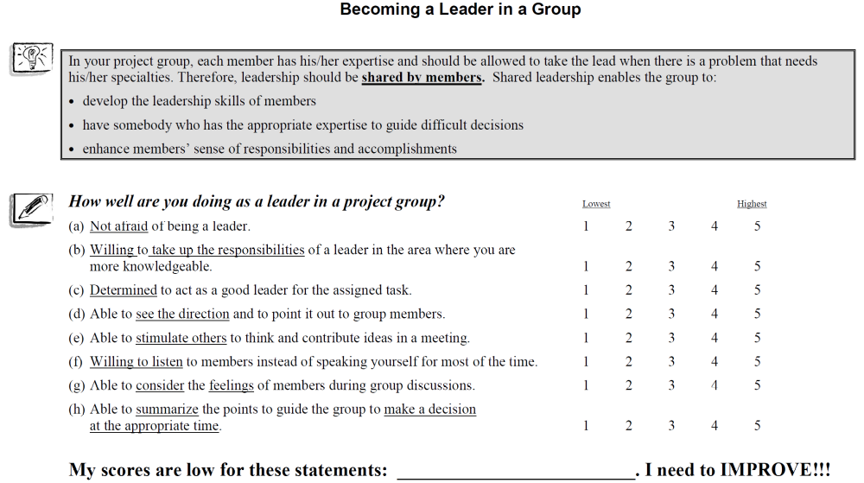

Slide 20
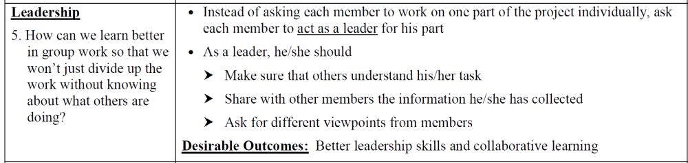

Slide 21
Reflect on your group work

